Slide 1
Unit 2 : ENTITY-RELATIONSHIP MODEL

Slide 2
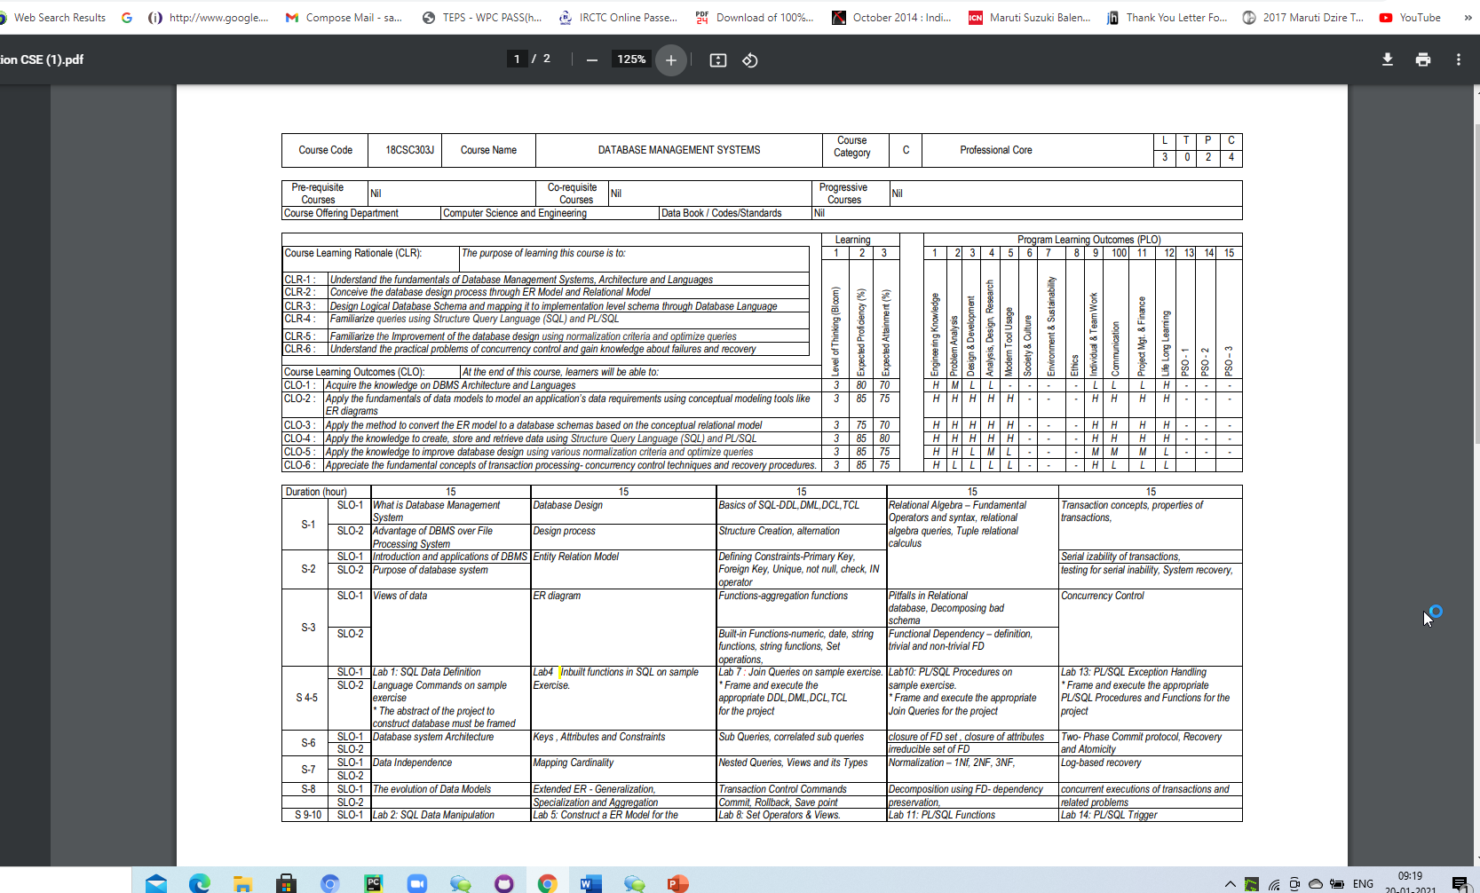

Slide 3
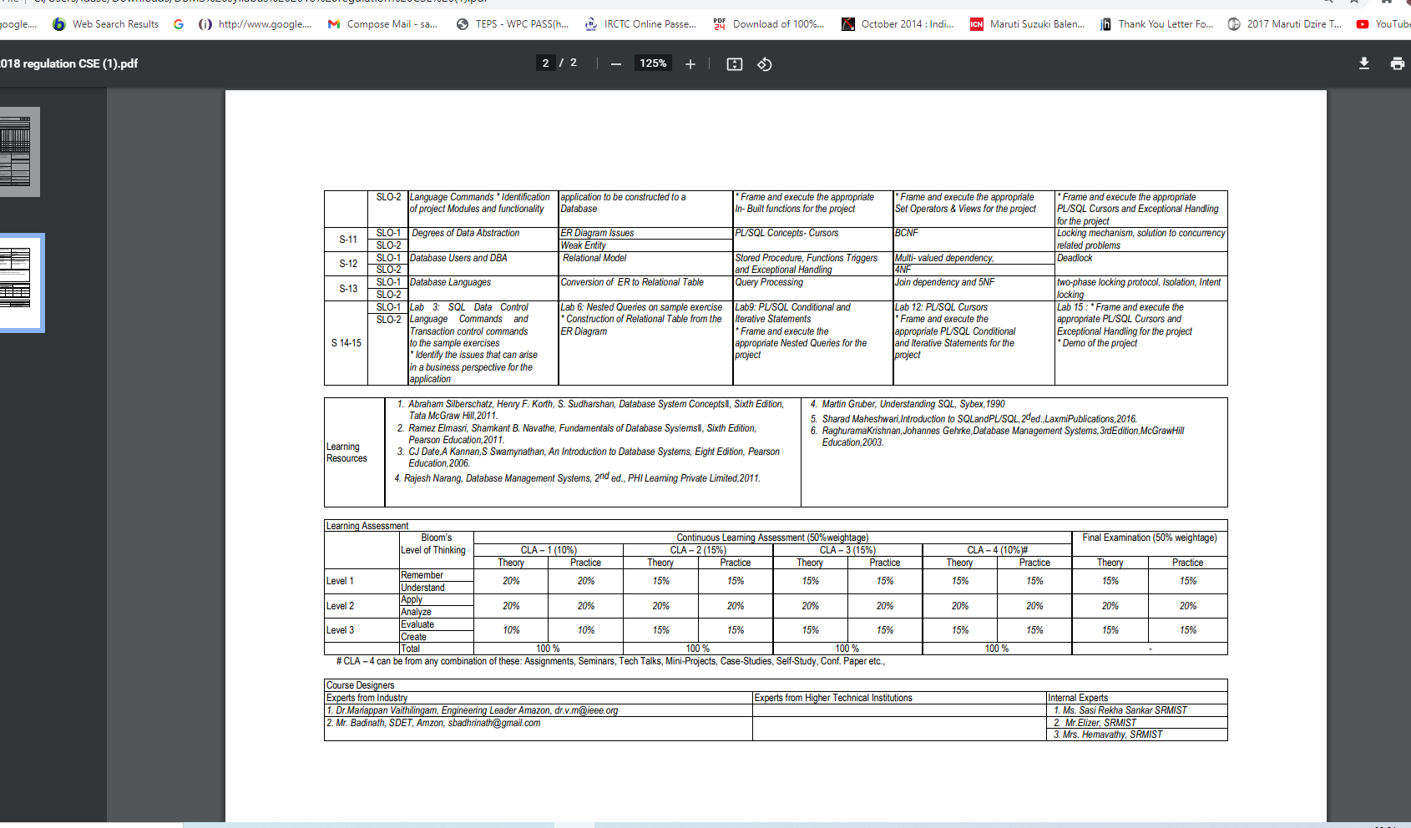

Slide 4
Course Learning Rationale (CLR)
Conceive the database design process through ER Model and Relational Model
To overcome the following issues during design phase, we can use E-R Model
- Redundancy and Incompleteness

Slide 5
Course Learning Outcomes (CLO)
Apply the fundamentals of data models to model an application’s data requirements using conceptual modeling tools like ER diagrams

Slide 6
Entity Sets
Relationship Sets
Mapping Constraints
Keys
Design Issues
E-R Diagram
Extended E-R Features
Design of an E-R Database Schema
Reduction of an E-R Schema to Tables

Slide 7
Entity Sets
The entity-relationship (E-R) data model was developed to facilitate database design by allowing specification of an enterprise schema that represents the overall logical structure of a database.
A database can be modeled as:
a collection of entities,
relationship among entities.
An entity is an object that exists and is distinguishable from other objects.
Example: specific person, company, event, plant
Entities have attributes Example: people have names and addresses
An entity set is a set of entities of the same type that share the same properties.
Example: set of all persons, companies, trees, holidays

Slide 8
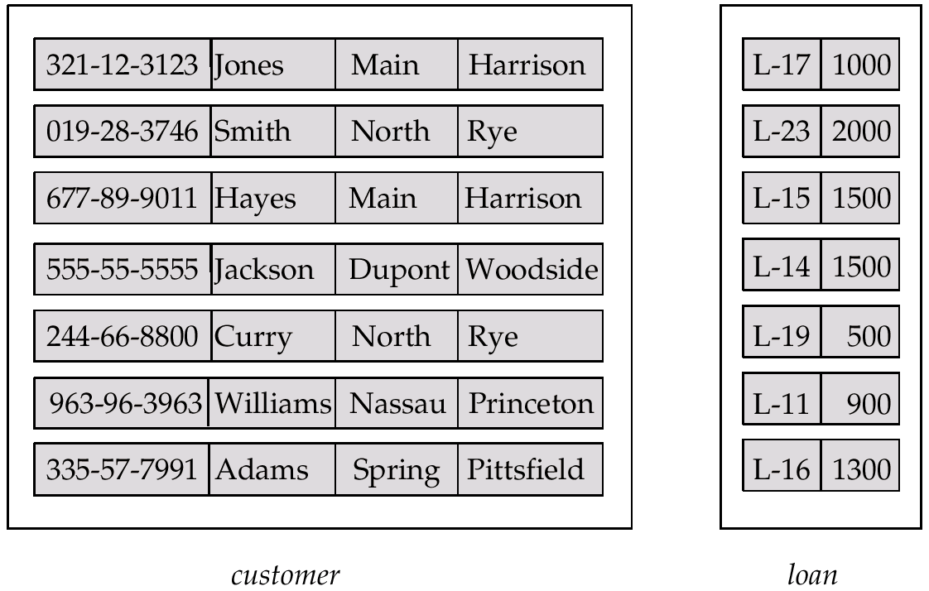
Entity Sets customer and loan
customer-id customer- customer- customer- loan- amount name street city number

Slide 9
Attributes
An entity is represented by a set of attributes, that is descriptive properties possessed by all members of an entity set.
Example:
customer = (customer-id, customer-name, customer-street,
customer-city) loan = (loan-number, amount)
Domain – the set of permitted values for each attribute
Attribute types:
Simple and composite attributes.
Single-valued and multi-valued attributes
E.g. multivalued attribute: phone-numbers
Derived attributes
Can be computed from other attributes
E.g. age, given date of birth

Slide 10
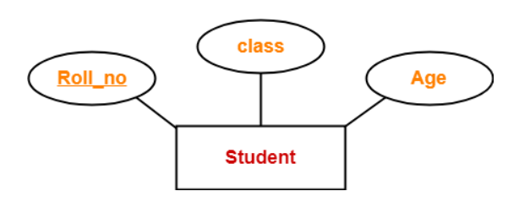
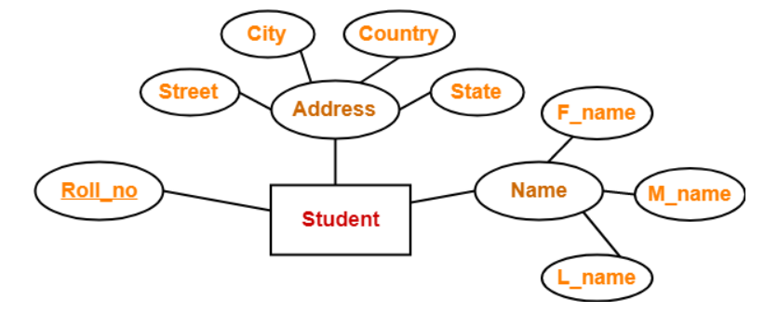
Simple Attributes: Simple attributes are those attributes which can not be divided further.
Composite Attributes-Composite attributes are those attributes which are composed of many other simple attributes. Here, the attributes “Name” and “Address” are composite attributes as they are composed of many other simple attributes.

Slide 11
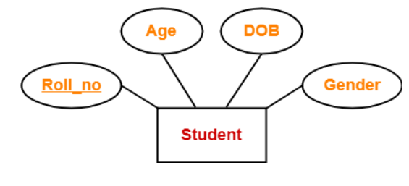
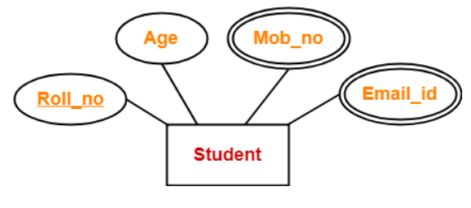
Single Valued Attributes-
Single valued attributes are those attributes which can take only one value for a given entity from an entity set. Here, all the attributes are single valued attributes as they can take only one specific value for each entity.
Multi Valued Attributes-Multi valued attributes are those attributes which can take more than one value for a given entity from an entity set. Here, the attributes “Mob_no” and “Email_id” are multi valued attributes as they can take more than one values for a given entity.

Slide 12
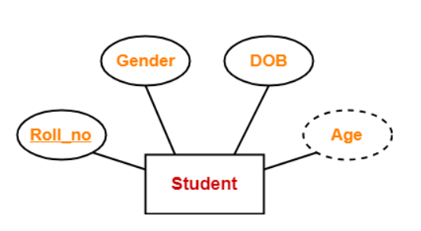
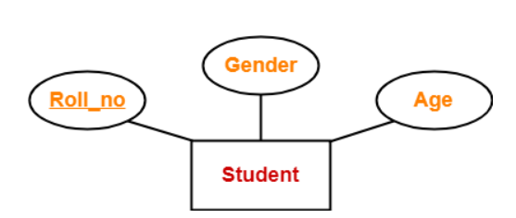
Derived Attributes-
Derived attributes are those attributes which can be derived from other attribute(s). Here, the attribute “Age” is a derived attribute as it can be derived from the attribute “DOB”.
Key Attributes-Key attributes are those attributes which can identify an entity uniquely in an entity set. Here, the attribute “Roll_no” is a key attribute as it can identify any student uniquely.

Slide 13
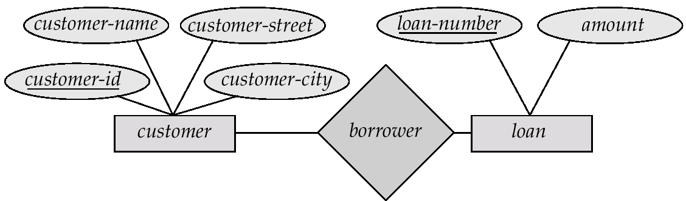
E-R Diagrams
(1) Basic Structure
Rectangles represent entity sets.
Diamonds represent relationship sets.
Lines link attributes to entity sets and entity sets to relationship sets.
Ellipses represent attributes
Double ellipses represent multivalued attributes.
Dashed ellipses denote derived attributes.
Underline indicates primary key attributes (will study later)

Slide 14
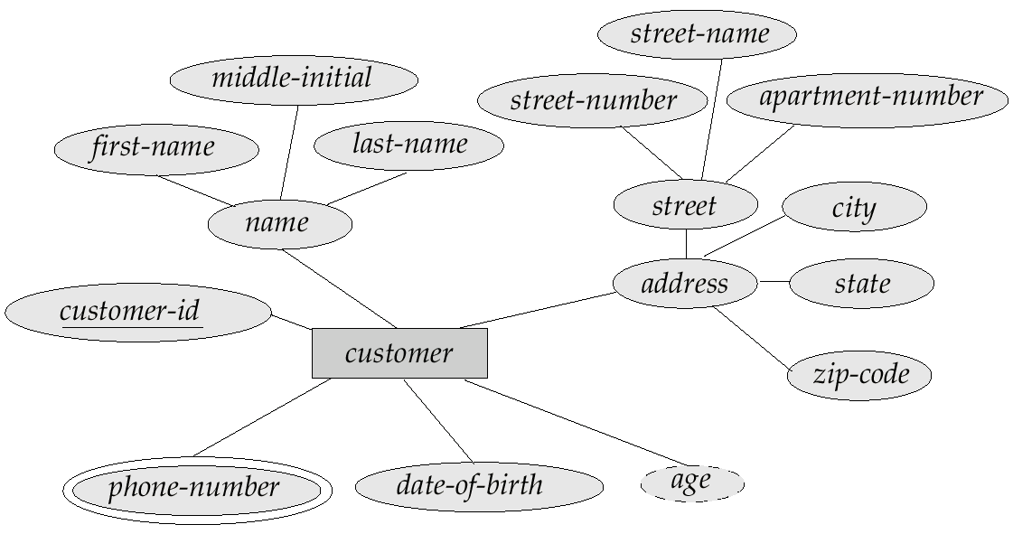
E-R Diagram With Composite, Multivalued, and Derived Attributes

Slide 15
Relationship Sets
A relationship is an association among several entities. For example, we can define a relationship depositor that associates customer Hayes with account A-102
Example: Hayes depositor A-102 customer entity relationship set account entity
A relationship set is a mathematical relation among n ≥ 2 entities, each taken from entity sets {(e₁, e₂, … e_{n}) | e₁ ∈ E₁, e₂ ∈ E₂, …, e_{n} ∈ E_{n}} where (e₁, e₂, …, e_{n}) is a relationship
Example:
(Hayes, A-102) ∈ depositor
The association between entity sets is referred to as participation; that is, the
entity sets E1, E2, . . . , En participate in relationship set R.
A relationship instance in an E-R schema represents an association between the named entities in the real-world enterprise that is being modelled.

Slide 16
Degree of a Relationship Set
Refers to number of entity sets that participate in a relationship set.
Relationship sets that involve two entity sets are binary (or degree two). Generally, most relationship sets in a database system are binary.
Relationship sets may involve more than two entity sets.
E.g. Suppose employees of a bank may have jobs (responsibilities) at multiple branches, with different jobs at different branches. Then there is a ternary relationship set between entity sets employee, job and branch
Relationships between more than two entity sets are rare. Most relationships are binary. (More on this later.)

Slide 17
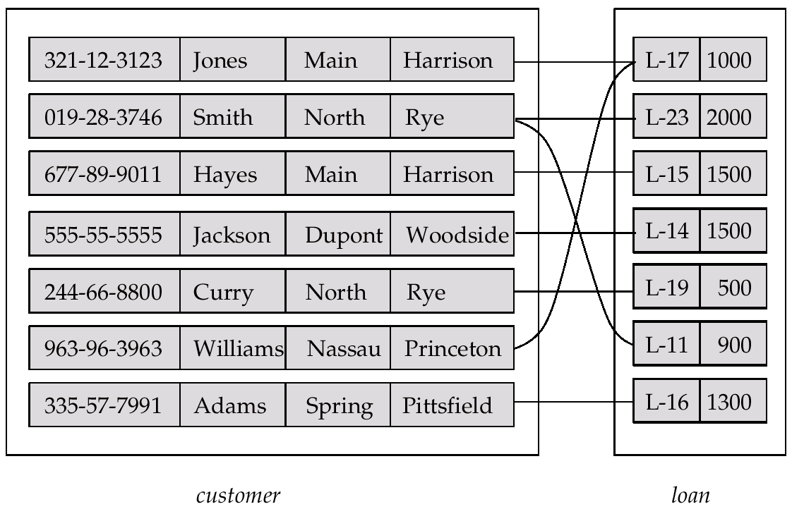
Relationship Set borrower

Slide 18
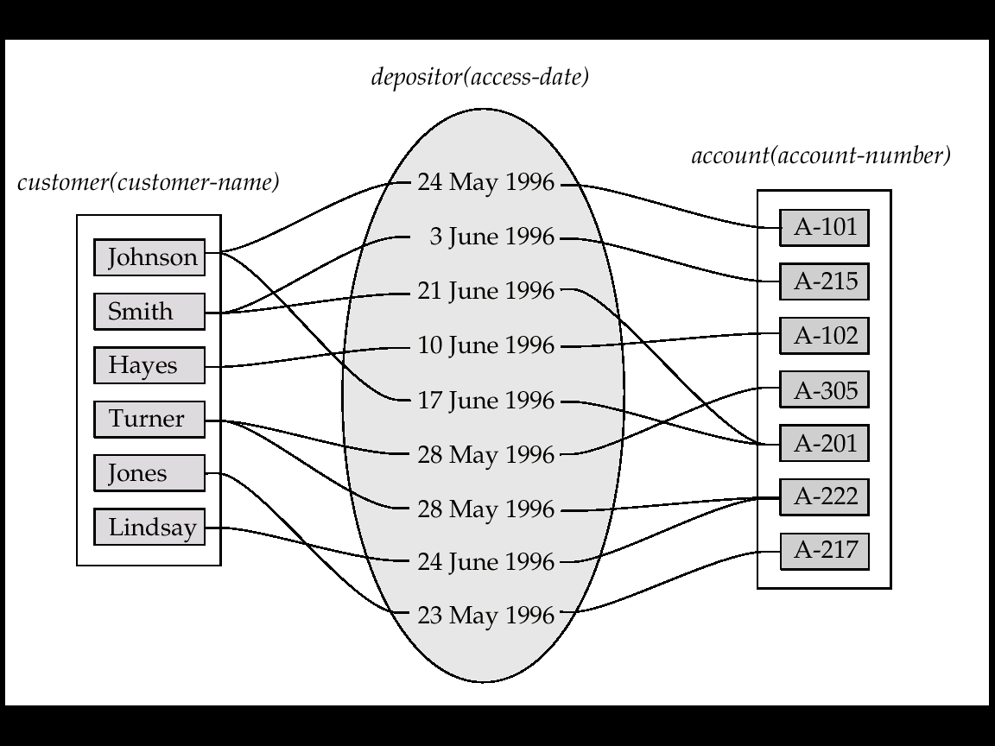
Relationship Sets (Cont.)
An attribute can also be property of a relationship set.
For instance, the depositor relationship set between entity sets customer and account may have the attribute access-date

Slide 19
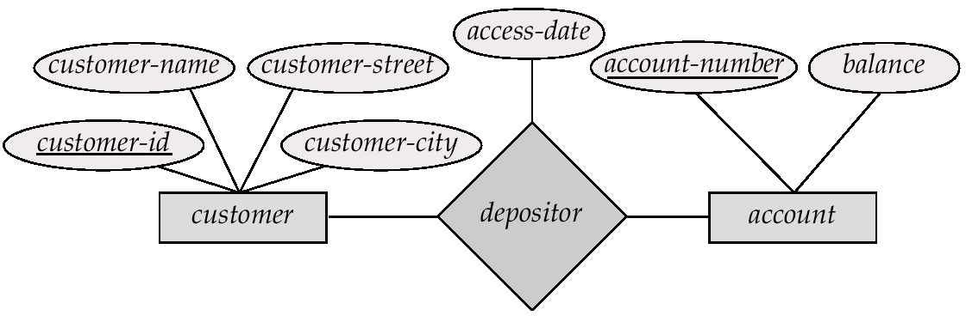
Relationship Sets with Attributes

Slide 20
(2) Mapping Cardinality
Express the number of entities to which another entity can be associated via a relationship set.
Most useful in describing binary relationship sets.
For a binary relationship set the mapping cardinality must be one of the following types:
One to one
One to many
Many to one
Many to many

Slide 21
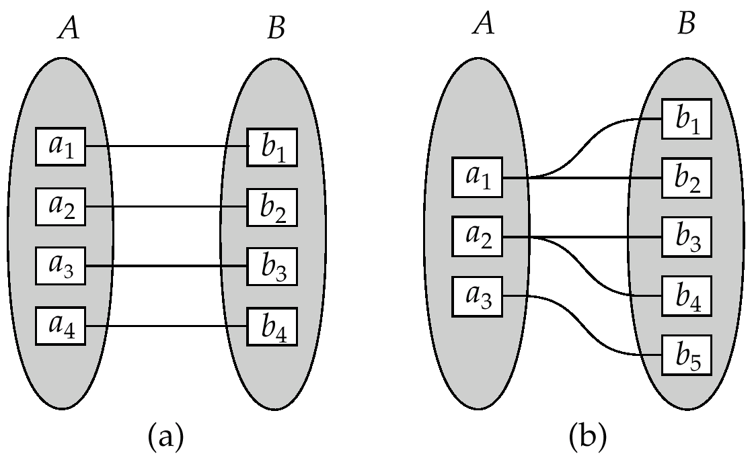
Mapping Cardinalities
One to one
One to many
Note: Some elements in A and B may not be mapped to any
elements in the other set

Slide 22
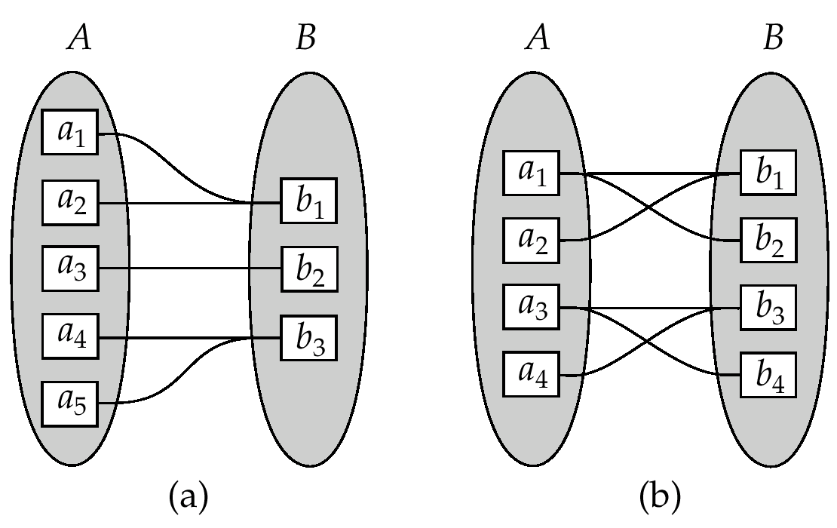
Mapping Cardinalities
Many to one
Many to many
Note: Some elements in A and B may not be mapped to any
elements in the other set

Slide 23
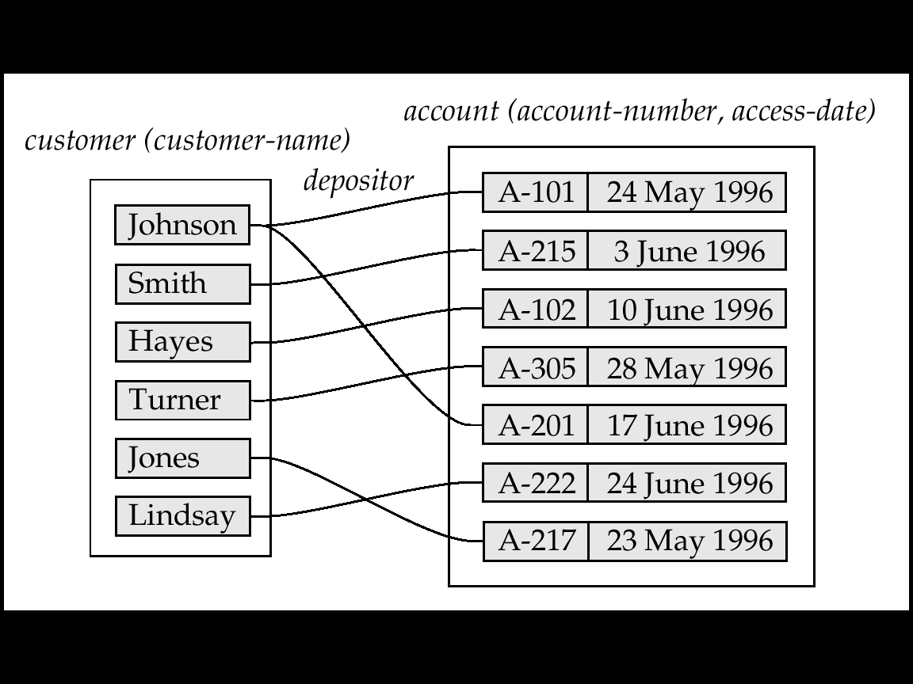
Mapping Cardinalities affect ER Design
Can make access-date an attribute of account, instead of a relationship attribute, if each account can have only one customer
I.e., the relationship from account to customer is many to one, or equivalently, customer to account is one to many

Slide 24
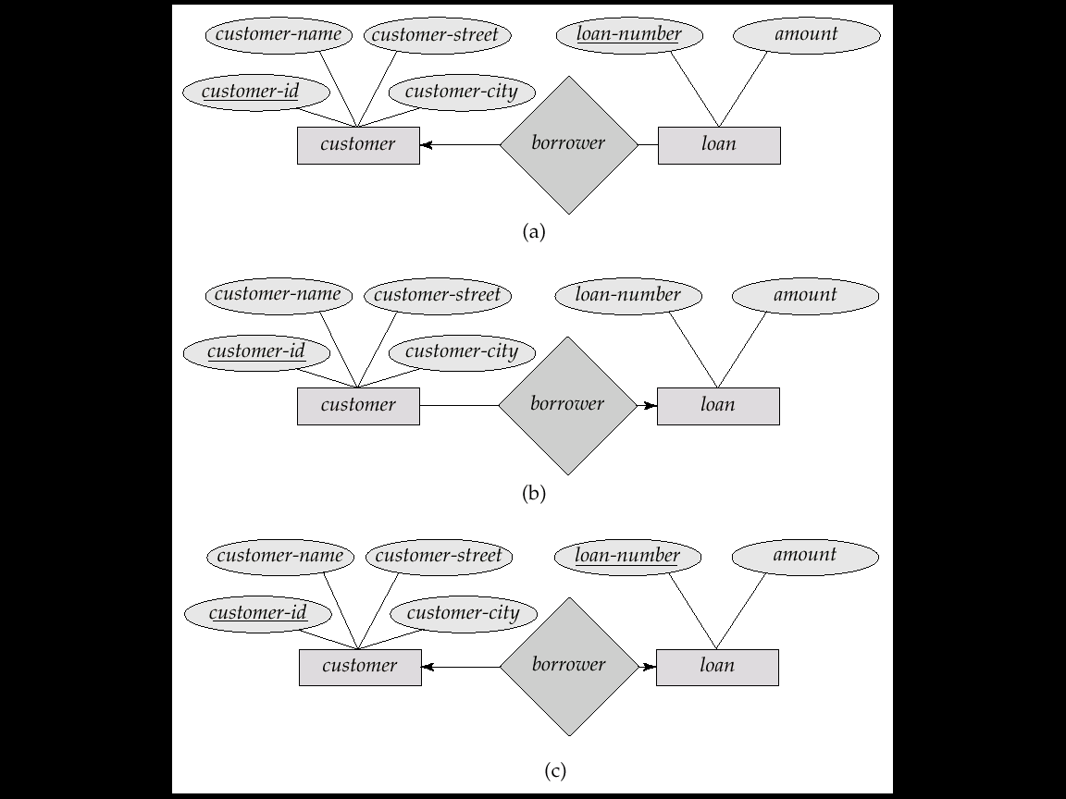
Cardinality Constraints
We express cardinality constraints by drawing either a directed line (→), signifying “one,” or an undirected line (—), signifying “many,” between the relationship set and the entity set.
E.g.: One-to-one relationship:
A customer is associated with at most one loan via the relationship borrower
A loan is associated with at most one customer via borrower

Slide 25
One-To-Many Relationship
In the one-to-many relationship a loan is associated with at most one customer via borrower, a customer is associated with several (including 0) loans via borrower

Slide 26
Many-To-One Relationships
In a many-to-one relationship a loan is associated with several (including 0) customers via borrower, a customer is associated with at most one loan via borrower

Slide 27
Many-To-Many Relationship
A customer is associated with several (possibly 0) loans via borrower
A loan is associated with several (possibly 0) customers via borrower

Slide 28
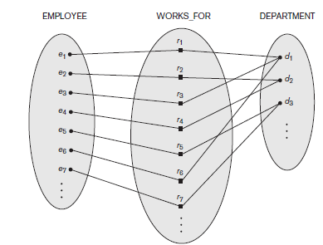
structural constraints of a relationship type
Participation Constraints and Existence Dependencies.
The participation constraint specifies whether the existence of an entity depends on its being related to another entity via the relationship type.
This constraint specifies the minimum number of relationship instances that each entity can participate in and is sometimes called the minimum cardinality constraint.
There are two types of participation constraints—total and partial—that we illustrate by example.
If a company policy states that every employee must work for a department, then an employee entity can exist only if it participates in at least one WORKS_FOR relationship instance.
Thus, the participation of EMPLOYEE in WORKS_FOR is called total participation, meaning that every entity in the total set of employee entities must be related to a department entity via WORKS_FOR.
Total participation is also called existence dependency.

Slide 29
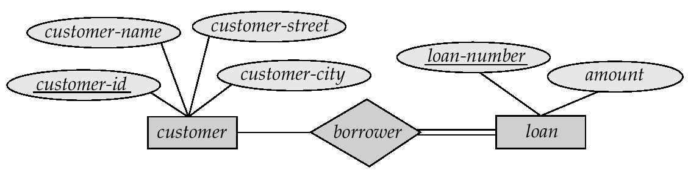
Participation of an Entity Set in a Relationship Set
Total participation (indicated by double line): every entity in the entity set participates in at least one relationship in the relationship set
E.g. participation of loan in borrower is total
every loan must have a customer associated to it via borrower
Partial participation: some entities may not participate in any relationship in the relationship set
E.g. participation of customer in borrower is partial

Slide 30
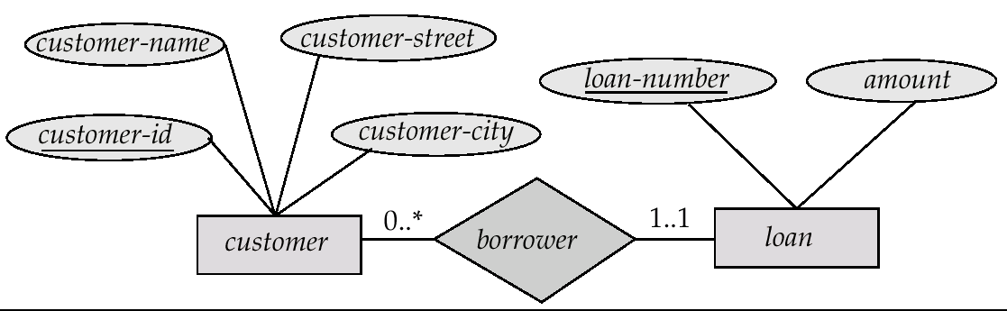
Complex attributes (Alternative Notation for Cardinality Limits)
Cardinality limits can also express participation constraints

Slide 31
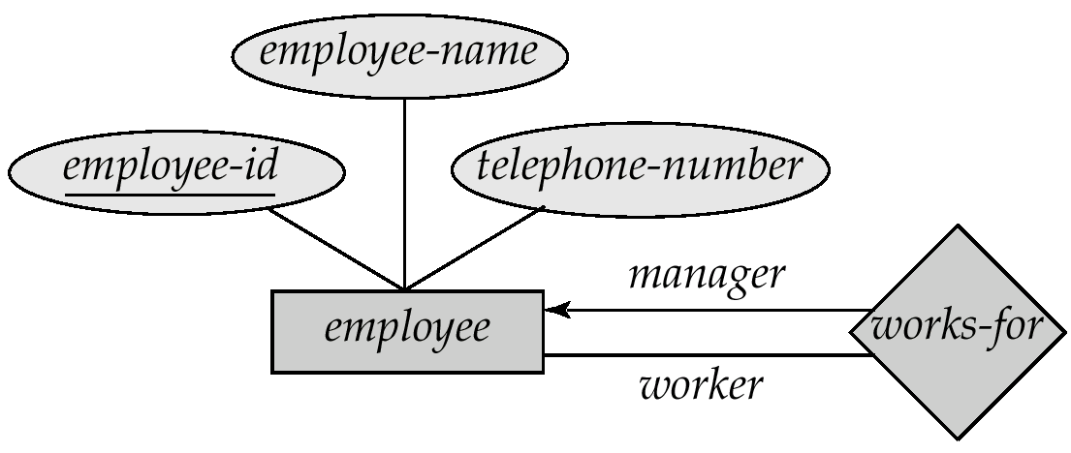
Roles
Entity sets of a relationship need not be distinct
The labels “manager” and “worker” are called roles; they specify how employee entities interact via the works-for relationship set.
Roles are indicated in E-R diagrams by labeling the lines that connect diamonds to rectangles.
Role labels are optional, and are used to clarify semantics of the relationship

Slide 32
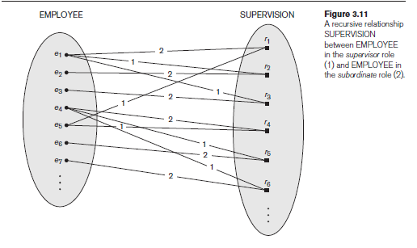
recursive relationships or self-referencing relationships.
In some cases the same entity type participates more than once in a relationship type in different roles. In such cases the role name becomes essential for distinguishing the meaning of the role that each participating entity plays.

Slide 33
Keys
A super key of an entity set is a set of one or more attributes whose values uniquely determine each entity.
A candidate key of an entity set is a minimal super key
Customer-id is candidate key of customer
account-number is candidate key of account
Although several candidate keys may exist, one of the candidate keys is selected to be the primary key.

Slide 34
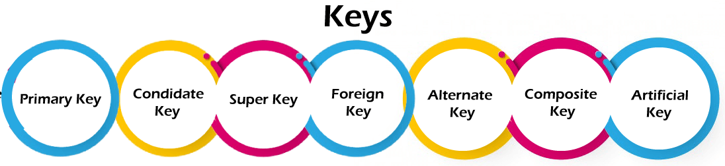
Keys An important constraint on an entity is the key. The key is an attribute or a group of attributes whose values can be used to uniquely identify an individual entity in an entity set. Types of Keys Candidate key Composite key Primary key Secondary key Foreign key Alternate key

Slide 35
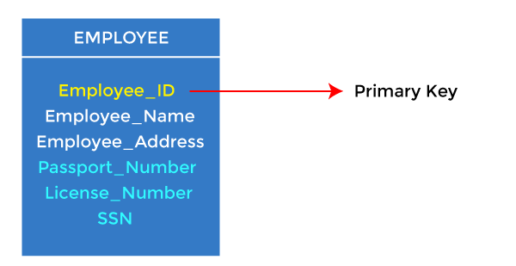
1. Primary key
It is the first key used to identify one and only one instance of an entity uniquely. An entity can contain multiple keys, as we saw in the PERSON table. The key which is most suitable from those lists becomes a primary key.
In the EMPLOYEE table, ID can be the primary key since it is unique for each employee. In the EMPLOYEE table, we can even select License_Number and Passport_Number as primary keys since they are also unique.
For each entity, the primary key selection is based on requirements and developers.
CREATE TABLE students
(
S_Id int NOT NULL,
LastName varchar (255) NOT NULL,
FirstName varchar (255),
Address varchar (255),
City varchar (255),
PRIMARY KEY (S_Id)
)

Slide 36
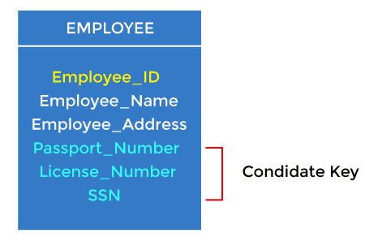
2. Candidate key
A candidate key is an attribute or set of attributes that can uniquely identify a tuple.
Except for the primary key, the remaining attributes are considered a candidate key. The candidate keys are as strong as the primary key.
For example: In the EMPLOYEE table, id is best suited for the primary key. The rest of the attributes, like SSN, Passport_Number, License_Number, etc., are considered a candidate key.
CREATE TABLE employee (
empno INTEGER NOT NULL PRIMARY KEY,
ss_no INTEGER NOT NULL UNIQUE,
ename CHAR (19),
sal NUMERIC (10, 2),
deptno INTEGER NOT NULL
) ;

Slide 37
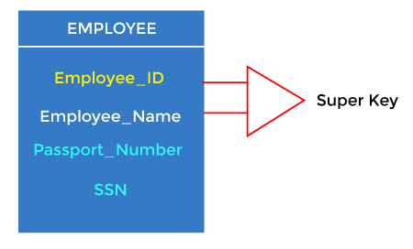
3. Super Key Super key is an attribute set that can uniquely identify a tuple. A super key is a superset of a candidate key.

Slide 38
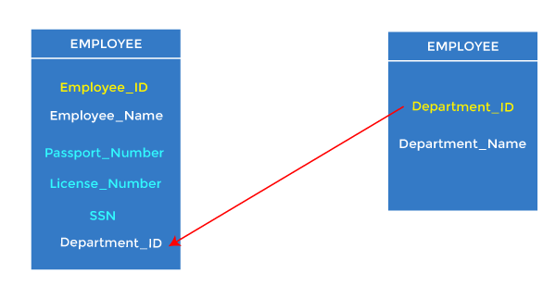
4. Foreign key
Foreign keys are the column of the table used to point to the primary key of another table.
Every employee works in a specific department in a company, and employee and department are two different entities. So we can't store the department's information in the employee table. That's why we link these two tables through the primary key of one table.
We add the primary key of the DEPARTMENT table, Department_Id, as a new attribute in the EMPLOYEE table.
In the EMPLOYEE table, Department_Id is the foreign key, and both the tables are related.
CREATE TABLE orders
(
O_Id int NOT NULL,
Order_No int NOT NULL,
S_Id int,
PRIMAY KEY (O_Id),
FOREIGN KEY (S_Id) REFERENCES Persons (S_Id)
)

Slide 39
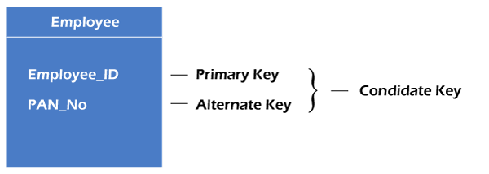
Alternate key
There may be one or more attributes or a combination of attributes that uniquely identify each tuple in a relation. These attributes or combinations of the attributes are called the candidate keys. One key is chosen as the primary key from these candidate keys, and the remaining candidate key, if it exists, is termed the alternate key.
In other words, the total number of the alternate keys is the total number of candidate keys minus the primary key. The alternate key may or may not exist. If there is only one candidate key in a relation, it does not have an alternate key.

Slide 40
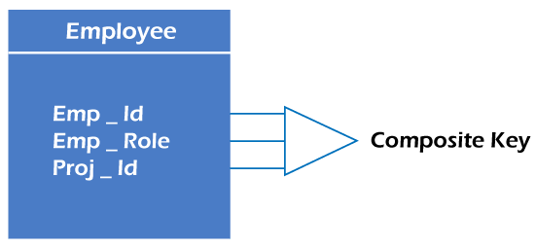
6. Composite key Whenever a primary key consists of more than one attribute, it is known as a composite key. This key is also known as Concatenated Key.
CREATE TABLE SAMPLE_TABLE
(COL1 integer,
COL2 nvarchar(30),
COL3 nvarchar(50),
PRIMARY KEY (COL1, COL2));

Slide 41
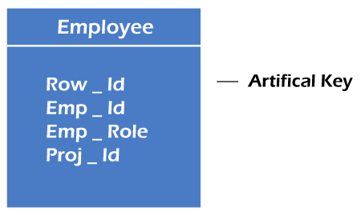
The key created using arbitrarily assigned data are known as artificial keys. These keys are created when a primary key is large and complex and has no relationship with many other relations. The data values of the artificial keys are usually numbered in a serial order.

Slide 42
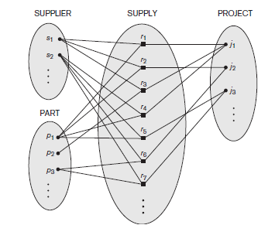
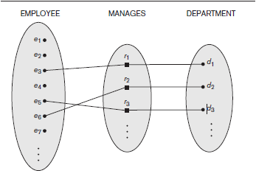
Quiz

Slide 43
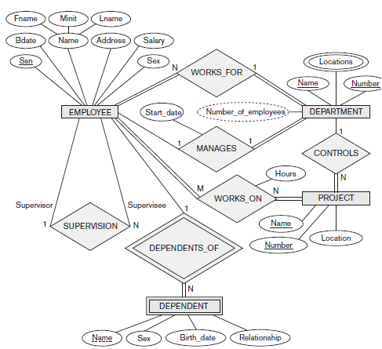

Slide 44
DBDiagram
ERDPlus
quickDBD
DrawSQl
LucidChart
Creately

Slide 45
Keys for Relationship Sets
The combination of primary keys of the participating entity sets forms a super key of a relationship set.
(customer-id, account-number) is the super key of depositor
NOTE: this means a pair of entity sets can have at most one relationship in a particular relationship set.
E.g. if we wish to track all access-dates to each account by each customer, we cannot assume a relationship for each access. We can use a multivalued attribute though
Must consider the mapping cardinality of the relationship set when deciding the what are the candidate keys
Need to consider semantics of relationship set in selecting the primary key in case of more than one candidate key

Slide 46
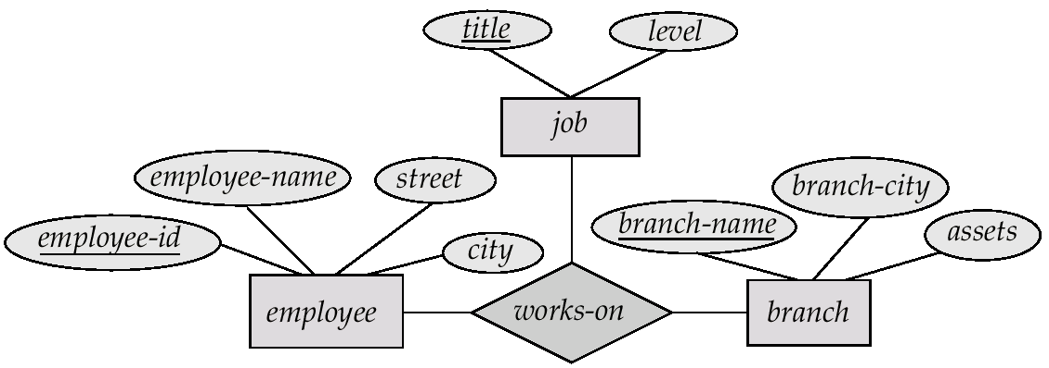
(5) E-R Diagram with a Ternary Relationship

Slide 47
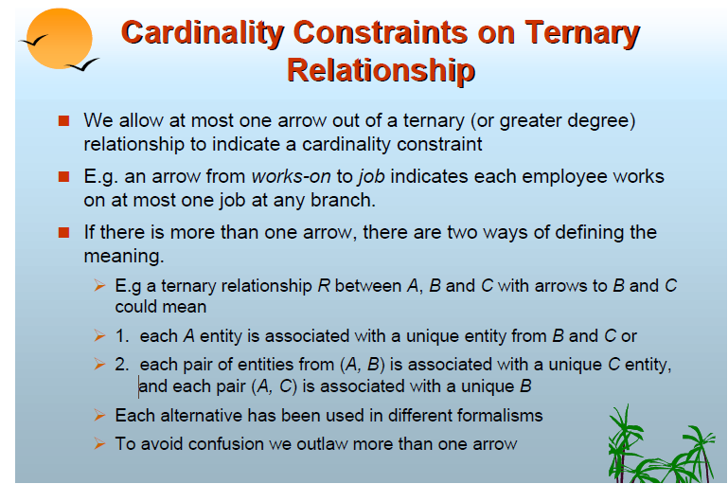
Higher-degree relationships are generally more complex than binary relationships;

Slide 48
In database management systems, relationships between entities are often represented using tables. Ternary relationships involve three entities, while binary relationships involve only two entities. Ternary relationships can be converted to binary relationships for several reasons.
One reason is that most Database Management Systems (DBMS) do not directly support ternary relationships.
DBMS typically provide support for binary relationships, and converting ternary relationships to binary relationships allows for easier implementation and management of the database.
Another reason for converting ternary relationships to binary relationships is to simplify the database design. By reducing the number of entities involved in a relationship, the database can be normalized and reduce redundancy. This can improve the efficiency and performance of the database system.

Slide 49
Binary Vs. Non-Binary Relationships
Some relationships that appear to be non-binary may be better represented using binary relationships
E.g. A ternary relationship parents, relating a child to his/her father and mother, is best replaced by two binary relationships, father and mother
Using two binary relationships allows partial information (e.g. only mother being know)
But there are some relationships that are naturally non-binary
E.g. works-on
Mother
Father child
Parent child

Slide 50
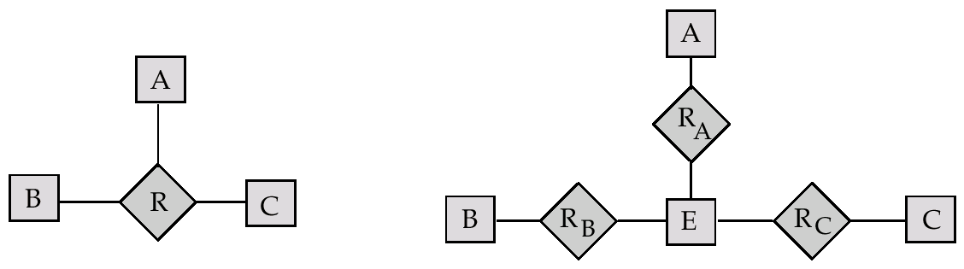
Converting Non-Binary Relationships to Binary Form
In general, any non-binary relationship can be represented using binary relationships by creating an artificial entity set.
Replace R between entity sets A, B and C by an entity set E, and three relationship sets:
1. R_{A}, relating E and A 2.R_{B}, relating E and B
3. R_{C}, relating E and C
Create a special identifying attribute for E
Add any attributes of R to E
For each relationship (a_{i} , b_{i} , c_{i}) in R, create
1. a new entity e_{i} in the entity set E 2. add (e_{i} , a_{i} ) to R_{A}
3. add (e_{i} , b_{i} ) to R_{B} 4. add (e_{i} , c_{i} ) to R_{C}

Slide 51
Converting Non-Binary Relationships (Cont.)
Also need to translate constraints
Translating all constraints may not be possible
There may be instances in the translated schema that cannot correspond to any instance of R
Exercise: add constraints to the relationships R_{A}, R_{B} and R_{C} to ensure that a newly created entity corresponds to exactly one entity in each of entity sets A, B and C
We can avoid creating an identifying attribute by making E a weak entity set (described shortly) identified by the three relationship sets

Slide 52
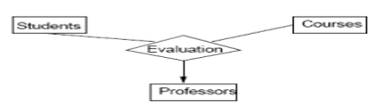

Slide 53
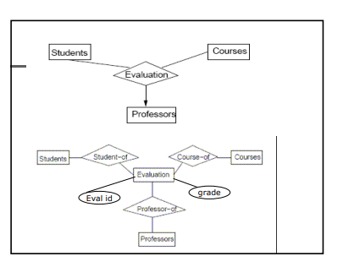

Slide 54
Design Issues
Use of entity sets vs. attributes Choice mainly depends on the structure of the enterprise being modeled, and on the semantics associated with the attribute in question.
Use of entity sets vs. relationship sets Possible guideline is to designate a relationship set to describe an action that occurs between entities
Binary versus n-ary relationship sets Although it is possible to replace any nonbinary (n-ary, for n > 2) relationship set by a number of distinct binary relationship sets, a n-ary relationship set shows more clearly that several entities participate in a single relationship.
Placement of relationship attributes

Slide 55
(6) Weak Entity Sets
An entity set that does not have a primary key is referred to as a weak entity set.
The existence of a weak entity set depends on the existence of a identifying entity set
it must relate to the identifying entity set via a total, one-to-many relationship set from the identifying to the weak entity set
Identifying relationship depicted using a double diamond
The discriminator (or partial key) of a weak entity set is the set of attributes that distinguishes among all the entities of a weak entity set.
The primary key of a weak entity set is formed by the primary key of the strong entity set on which the weak entity set is existence dependent, plus the weak entity set’s discriminator.

Slide 56
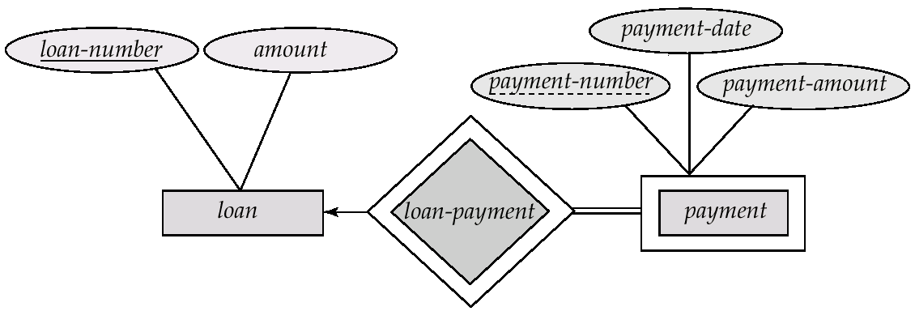
Weak Entity Sets (Cont.)
We depict a weak entity set by double rectangles.
We underline the discriminator of a weak entity set with a dashed line.
payment-number – discriminator of the payment entity set
Primary key for payment – (loan-number, payment-number)

Slide 57
Weak Entity Sets (Cont.)
Note: the primary key of the strong entity set is not explicitly stored with the weak entity set, since it is implicit in the identifying relationship.
If loan-number were explicitly stored, payment could be made a strong entity, but then the relationship between payment and loan would be duplicated by an implicit relationship defined by the attribute loan-number common to payment and loan

Slide 58
More Weak Entity Set Examples
In a university, a course is a strong entity and a course-offering can be modeled as a weak entity
The discriminator of course-offering would be semester (including year) and section-number (if there is more than one section)
If we model course-offering as a strong entity we would model course-number as an attribute.
Then the relationship with course would be implicit in the course-number attribute

Slide 59
Extended ER Features (1) Specialization
Top-down design process; we designate subgroupings within an entity set that are distinctive from other entities in the set.
These subgroupings become lower-level entity sets that have attributes or participate in relationships that do not apply to the higher-level entity set.
Depicted by a triangle component labeled ISA (E.g. customer “is a” person).
Attribute inheritance – a lower-level entity set inherits all the attributes and relationship participation of the higher-level entity set to which it is linked.

Slide 60
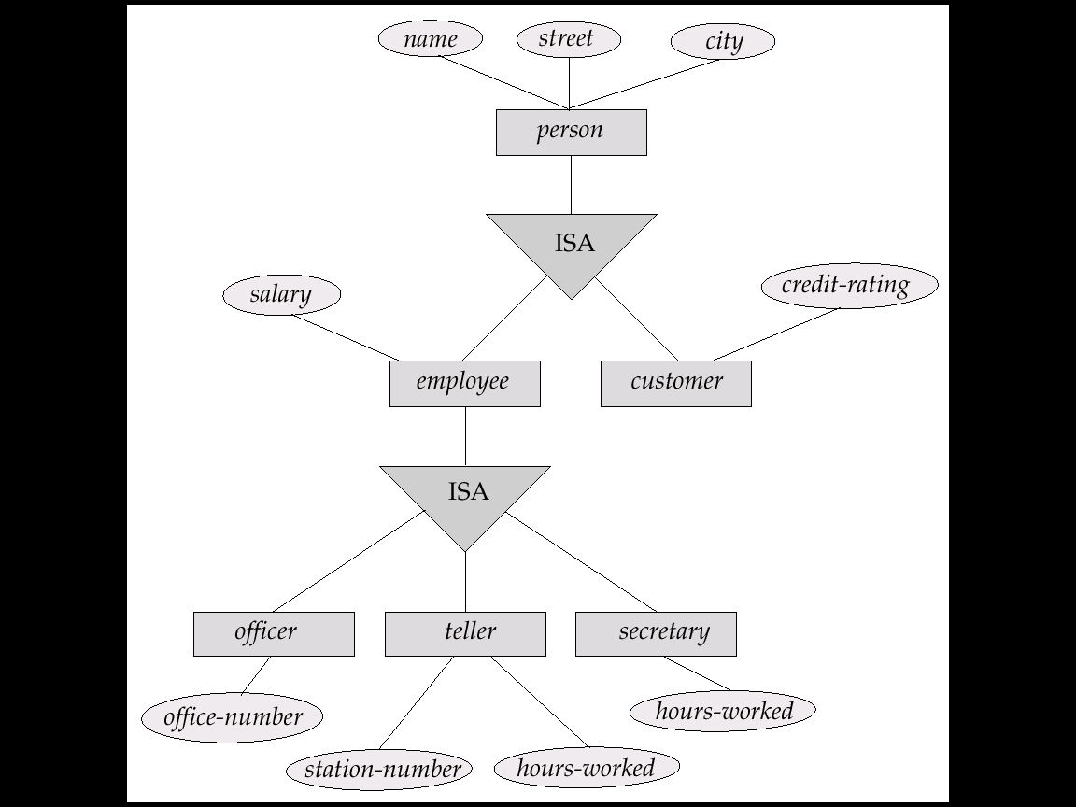
Specialization Example

Slide 61
(2) Generalization
A bottom-up design process – combine a number of entity sets that share the same features into a higher-level entity set.
Specialization and generalization are simple inversions of each other; they are represented in an E-R diagram in the same way.
The terms specialization and generalization are used interchangeably.

Slide 62
Specialization and Generalization (Contd.)
Can have multiple specializations of an entity set based on different features.
E.g. permanent-employee vs. temporary-employee, in addition to officer vs. secretary vs. teller
Each particular employee would be
a member of one of permanent-employee or temporary-employee,
and also a member of one of officer, secretary, or teller
The ISA relationship also referred to as superclass - subclass relationship

Slide 63
(3) Attribute Inheritance
A crucial property of the higher- and lower-level entities created by specialization and generalization is attribute inheritance.
The attributes of the higher-level entity sets are said to be inherited by the lower-level entity sets.
For example, student and employee inherit the attributes of person.
A higher-level entity set with attributes and relationships that apply to all of its lower-level entity sets.
Lower-level entity sets with distinctive features that apply only within a particular lower-level entity set.
Single inheritance
Multiple inheritance

Slide 64
(4) Design Constraints on a Specialization/Generalization
(i) condition-defined
In a condition-defined lower-level entity sets, membership is evaluated on the basis of whether or not an entity satisfies an explicit condition or predicate.
E.g. all customers over 65 years are members of senior-citizen entity set; senior-citizen ISA person.
For example, assume that the higher-level entity set student has the attribute student type. All student entities are evaluated on the defining student type attribute. Only those entities that satisfy the condition student type = “graduate” are allowed to belong to the lower-level entity set graduate student. (This type of generalization is attribute-defined)
(ii) user-defined
User-defined lower-level entity sets are not constrained by a membership condition; rather, the database user assigns entities to a given entity set.
For instance, let us assume that, after 3 months of employment, university employees are assigned to one of four work teams. The user in charge of this decision makes the team assignment on an individual basis.
(iii) Disjoint
A disjointness constraint requires that an entity belong to no more than one lower-level entity set. That is, an entity can belong to only one lower-level entity set
Ex: A student can be either a graduate student or an undergraduate student, but cannot be both.
(iv) Overlapping
the same entity may belong to more than one lower-level entity set within a single generalization.
Ex: certain employees participate in more than one work team

Slide 65
Design Constraints on a Specialization/Generalization (Contd.)
Completeness constraint -- specifies whether or not an entity in the higher-level entity set must belong to at least one of the lower-level entity sets within the generalization/specialization
This constraint may be one of the following:
Total generalization or specialization. Each higher-level entity must belong
to a lower-level entity set.
Partial generalization or specialization. Some higher-level entities may not
belong to any lower-level entity set.

Slide 66
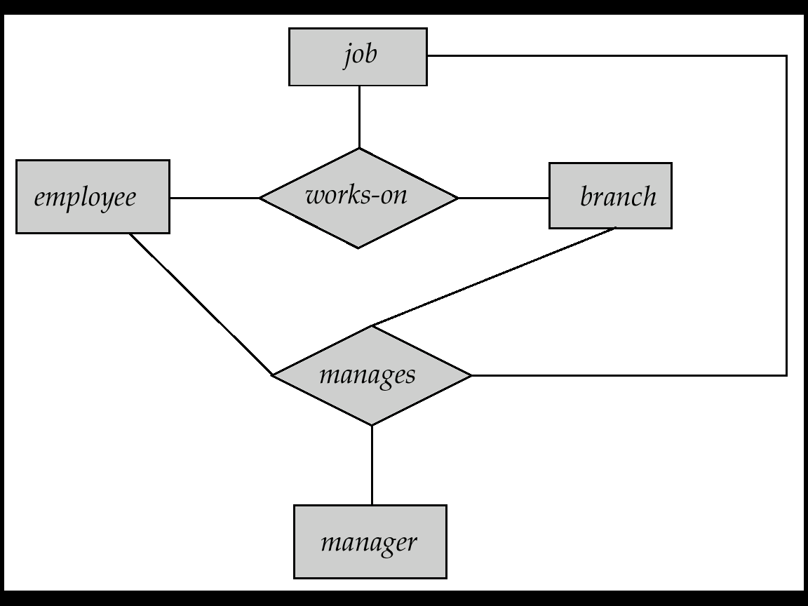
(5) Aggregation
Consider the ternary relationship works-on, which we saw earlier
Suppose we want to record managers for tasks performed by an employee at a branch

Slide 67
Aggregation (Cont.)
Relationship sets works-on and manages represent overlapping information
Every manages relationship corresponds to a works-on relationship
However, some works-on relationships may not correspond to any manages relationships
So we can’t discard the works-on relationship
Eliminate this redundancy via aggregation
Treat relationship as an abstract entity
Allows relationships between relationships
Abstraction of relationship into new entity
Without introducing redundancy, the following diagram represents:
An employee works on a particular job at a particular branch
An employee, branch, job combination may have an associated manager

Slide 68
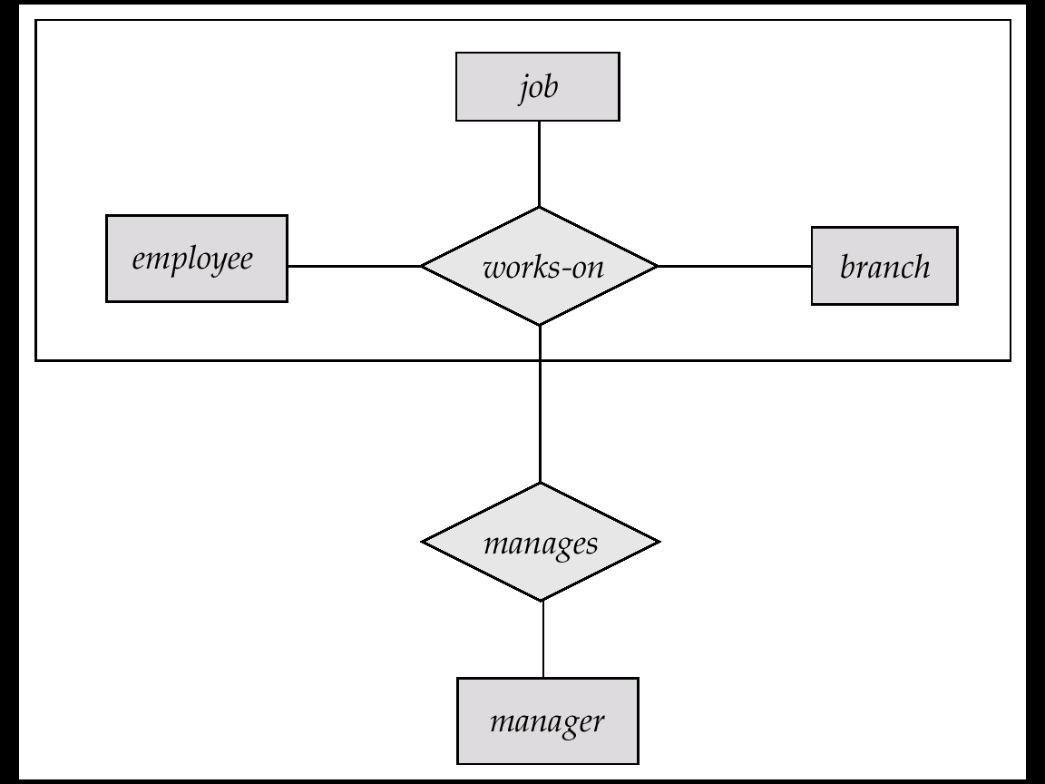
E-R Diagram With Aggregation

Slide 69
E-R Design Decisions
The use of an attribute or entity set to represent an object.
Whether a real-world concept is best expressed by an entity set or a relationship set.
The use of a ternary relationship versus a pair of binary relationships.
The use of a strong or weak entity set.
The use of specialization/generalization – contributes to modularity in the design.
The use of aggregation – can treat the aggregate entity set as a single unit without concern for the details of its internal structure.

Slide 70
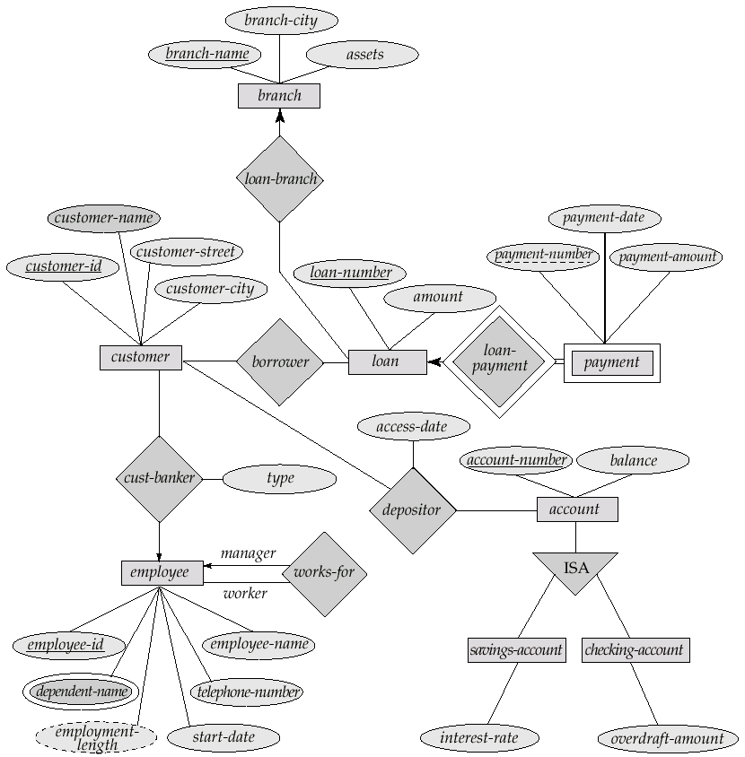
E-R Diagram for a Banking Enterprise

Slide 71
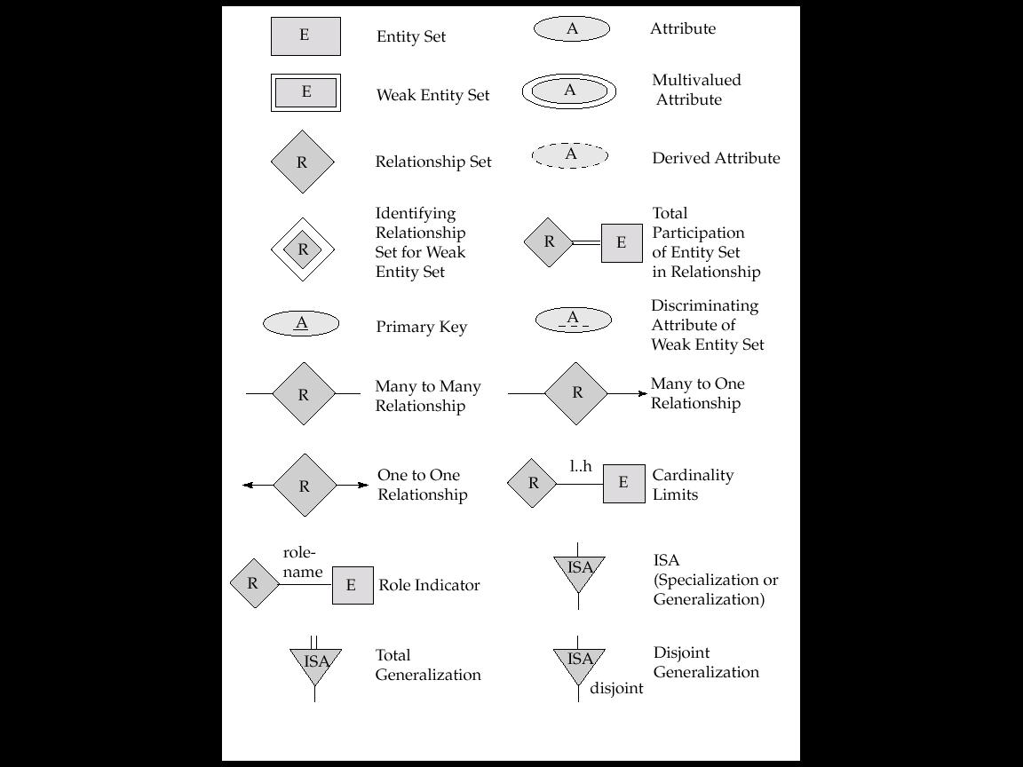
Summary of Symbols Used in E-R Notation

Slide 72
Summary of Symbols (Cont.)

Slide 73
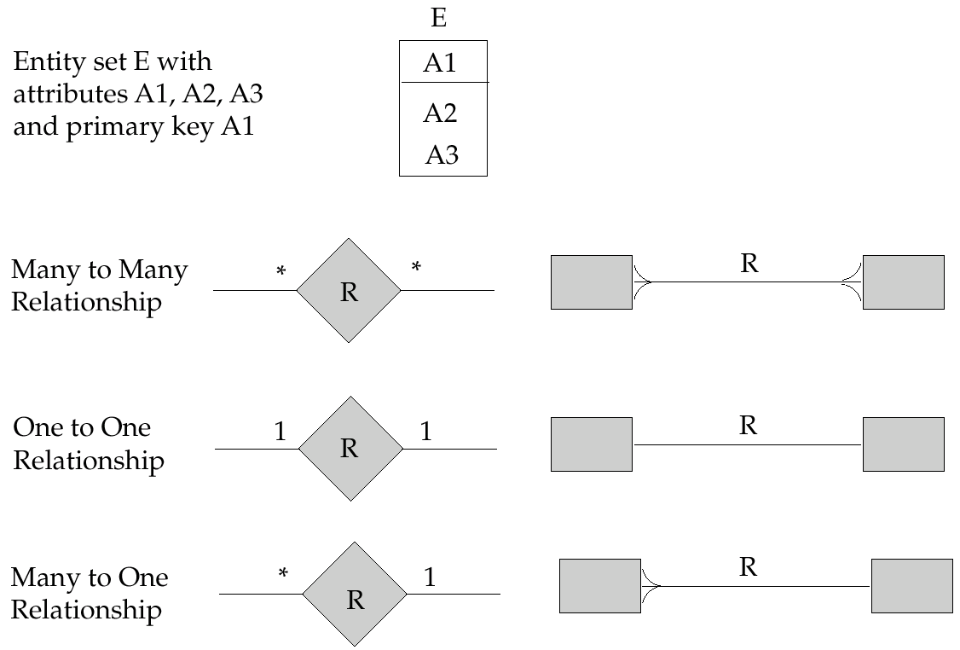
Alternative E-R Notations

Slide 74
Reduction of an E-R Schema to Tables
Primary keys allow entity sets and relationship sets to be expressed uniformly as tables which represent the contents of the database.
A database which conforms to an E-R diagram can be represented by a collection of tables.
For each entity set and relationship set there is a unique table which is assigned the name of the corresponding entity set or relationship set.
Each table has a number of columns (generally corresponding to attributes), which have unique names.
Converting an E-R diagram to a table format is the basis for deriving a relational database design from an E-R diagram.

Slide 75
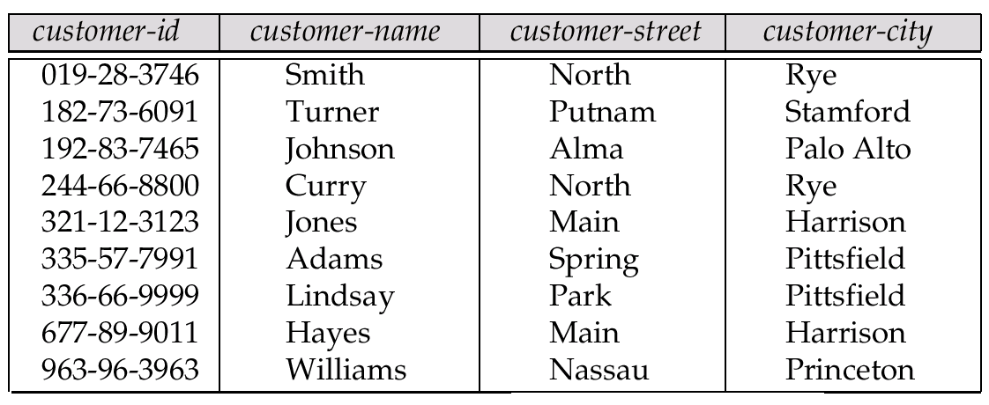
Representing Entity Sets as Tables
A strong entity set reduces to a table with the same attributes.

Slide 76
Composite and Multivalued Attributes
Composite attributes are flattened out by creating a separate attribute for each component attribute
E.g. given entity set customer with composite attribute name with component attributes first-name and last-name the table corresponding to the entity set has two attributes name.first-name and name.last-name
A multivalued attribute M of an entity E is represented by a separate table EM
Table EM has attributes corresponding to the primary key of E and an attribute corresponding to multivalued attribute M
E.g. Multivalued attribute dependent-names of employee is represented by a table employee-dependent-names( employee-id, dname)
Each value of the multivalued attribute maps to a separate row of the table EM
E.g., an employee entity with primary key John and dependents Johnson and Johndotir maps to two rows: (John, Johnson) and (John, Johndotir)

Slide 77
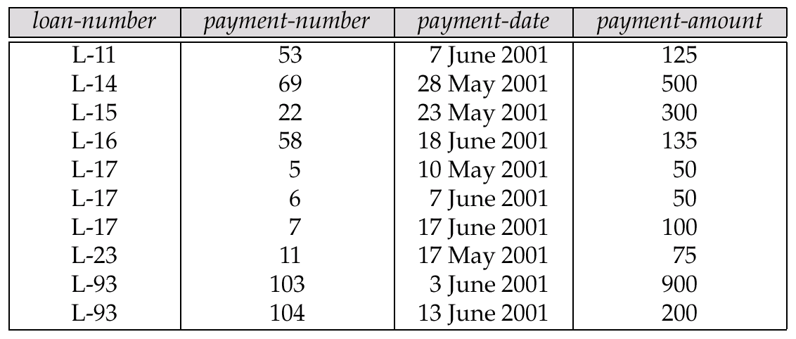
Representing Weak Entity Sets
A weak entity set becomes a table that includes a column for the primary key of the identifying strong entity set

Slide 78
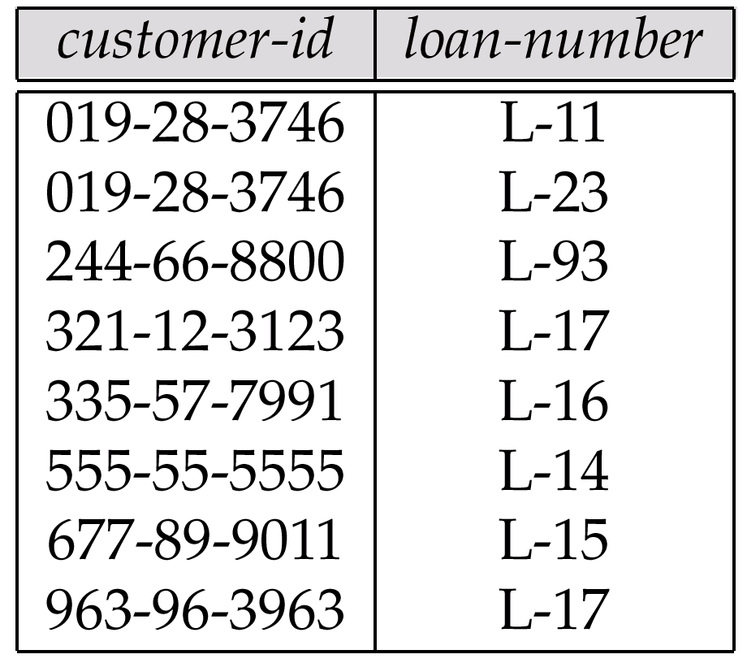
Representing Relationship Sets as Tables
A many-to-many relationship set is represented as a table with columns for the primary keys of the two participating entity sets, and any descriptive attributes of the relationship set.
E.g.: table for relationship set borrower

Slide 79
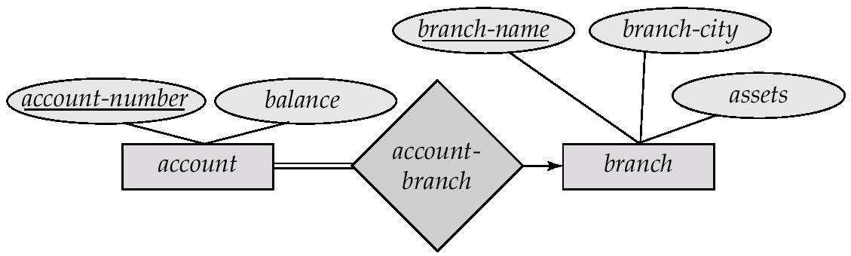
Redundancy of Tables
Many-to-one and one-to-many relationship sets that are total on the many-side can be represented by adding an extra attribute to the many side, containing the primary key of the one side
E.g.: Instead of creating a table for relationship account-branch, add an attribute branch to the entity set account

Slide 80
Redundancy of Tables (Cont.)
For one-to-one relationship sets, either side can be chosen to act as the “many” side
That is, extra attribute can be added to either of the tables corresponding to the two entity sets
If participation is partial on the many side, replacing a table by an extra attribute in the relation corresponding to the “many” side could result in null values
The table corresponding to a relationship set linking a weak entity set to its identifying strong entity set is redundant.
E.g. The payment table already contains the information that would appear in the loan-payment table (i.e., the columns loan-number and payment-number).

Slide 81
Representing Specialization as Tables
Method 1:
Form a table for the higher level entity
Form a table for each lower level entity set, include primary key of higher level entity set and local attributes table table attributes person name, street, city customer name, credit-rating employee name, salary
Drawback: getting information about, e.g., employee requires accessing two tables

Slide 82
Representing Specialization as Tables (Cont.)
Method 2:
Form a table for each entity set with all local and inherited attributes table table attributes person name, street, city customer name, street, city, credit-rating employee name, street, city, salary If specialization is total, no need to create table for generalized entity (person)
Drawback: street and city may be stored redundantly for persons who are both customers and employees

Slide 83
Relations Corresponding to Aggregation
To represent aggregation, create a table containing
primary key of the aggregated relationship,
the primary key of the associated entity set
Any descriptive attributes

Slide 84
Relations Corresponding to Aggregation (Cont.)
E.g. to represent aggregation manages between relationship works-on and entity set manager, create a table manages(employee-id, branch-name, title, manager-name)
Table works-on is redundant provided we are willing to store null values for attribute manager-name in table manages

Slide 85

ER-Diagram-Example
Univ. Registrar

Slide 86

Banking application

Slide 87

Book Store

Slide 88

TV Series Database

Slide 89

Music collection

Slide 90

Photo Shop

Slide 91

Literature search

Slide 92
Thank You

